Slide 1



Cal Football Analytics Project
Deliverable Presentation
Notes:
Introduction

Slide 2






Our Team
Jeremy Levitt
Nate Tran
Eric Herrmann
Austin Cheng
Andrew Rall
Charlie Xu
Notes:
Briefly introduce our team.

Slide 3


Goal:
Build an easy-to-use and informative Fourth-Down Decision Chart
Analyze
to Maximize EPV
Expected Point Value
(EPV)
Adjust to Matchup
Notes:
Speaker notes
Eric Herrmann:
The goal of this project was to build a robust yet easy to use 4th down decision-making chart, similar to what Championship analytics was providing for Cal Football between 2017 and 2018, but different in a few key aspects. Based on over 2,000,000 data points, our chart is intended to be as informative as possible, not only providing the decisions which maximize expected points per possession, but also providing the coaches with the expected possession value of each decision, giving the coaching staff with a resource that backs its own decisions up. Similar to Championship analytics, our model has a rigorous matchup analysis to fine tune each decision to the opponent we are playing.

Slide 4

Decision Chart:
Conversion
Percentage
Negative Consequences
Suggested
Decision
Notes:
Speaker notes
Eric Herrmann:
Once again, the goal was to make the chart as useful and informative as possible. We wanted the coaching staff to fully know how likely they were to be successful if they opted to go for it on 4th down, so we included a confidence percentage in the chart. Also, sometimes, we fall short of converting on 4th down, so also included in the chart is the expected negative ramifications of attempting to convert and failing. These two numbers help augment the suggested decision by providing the coaching staff with additional information in cases where they might want to know exactly how good or bad the situation is. In certain cases, the coaching staff may choose to make their own decision independent of the suggested decisions, and these additional metrics might be useful in helping them to do so.

Slide 5
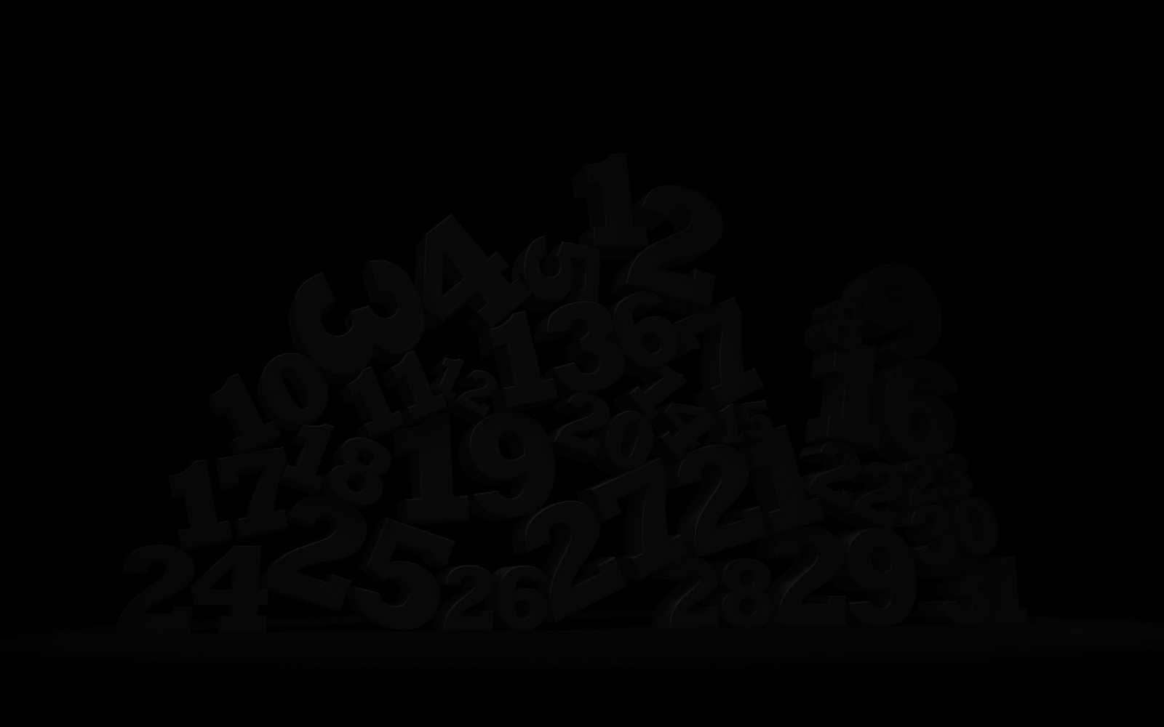

Comparison with Championship Analytics
 | Thin Booklet | Suggested Decision | Matchup Analysis | Raw Values | Close-call Identification
Our Chart
Champion Analytics
Notes:
Speaker notes
Charlie Xu:
Here is a comparison between our charts and Championship Analytics charts. First of all, the biggest is the thickness of the booklet. It is much easier to carry our charts around and look up information in crunch time. Second, though both charts have information on decisions and matchup analysis, our charts provide much more details on the rationales of making the decisions. As you can see on the sample charts, we provide raw values of confidence of converting and the consequences of turnover on downs all by yard lines. In addition, there are expected point values for go-for-it, punt, and field goal tries. Next up, Andrew will explain things to be mindful about when using the chart and formally what expected-point-values are.

Slide 6

What is Expected Point Value?
EPV: Average (or expected) points a team will gain or lose on next score for any given situation
Broken down by 3 potential Fourth Down Decisions
Go For It
Field Goal
Punt
Notes:
Speaker Notes
Jeremy Levitt: Expected Point Value is the fundamental measure of our model and our suggested decision. Expected point value can be defined technically as what you can see on the slide. A more common-sense definition of expected points can be expressed as follows: over hundreds of thousands of games, given the yardline and the yards to go, the expected points of a certain decision would be the average number of points scored making that decision in each game. Of course, each decision that can be made on 4th down- go for it, field goal, or punt- would therefore have their own corresponding expected point values.

Slide 7

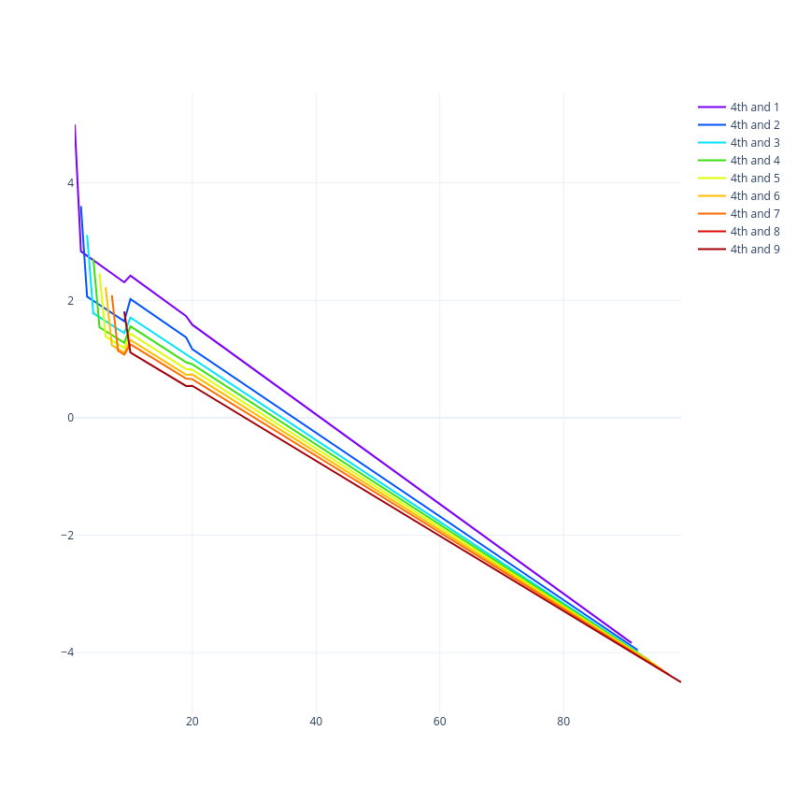
Go EPV by Yard Line
EPVs By Yardline
Expected Possession Value (Points)
Yard Line (Goal to 100)
Notes:
Speaker Notes
Jeremy Levitt: This graph depicts the expected points of “go for it” decision by yardline and yardstogo. A few things should be noted:
The expected points decreases as you get further and further from your endzone, which follows intuition.
As yards-to-go increases, the graph of the expected points is shifted down, which also follows intuition.
The “spike” in EPV at the end of each of the graphs. This spike is specifically at where the yardline is equal to the yards to go. So, for 4th and 1, this spike occurs at the 1 yard line. Other examples of where this spike occurs would be 4th and 2 at the 2, 4th and 3 at the 3, and so on. This spike occurs because if Cal does convert at these yardlines with yardstogo, there are no other dependent plays to gain points. If Cal converts 4th and 1 at the 1, it is always a touchdown. However, if Cal converts 4th and 1 at the 8 yardline, Cal may run several more plays before they score, IF they even score.

Slide 8

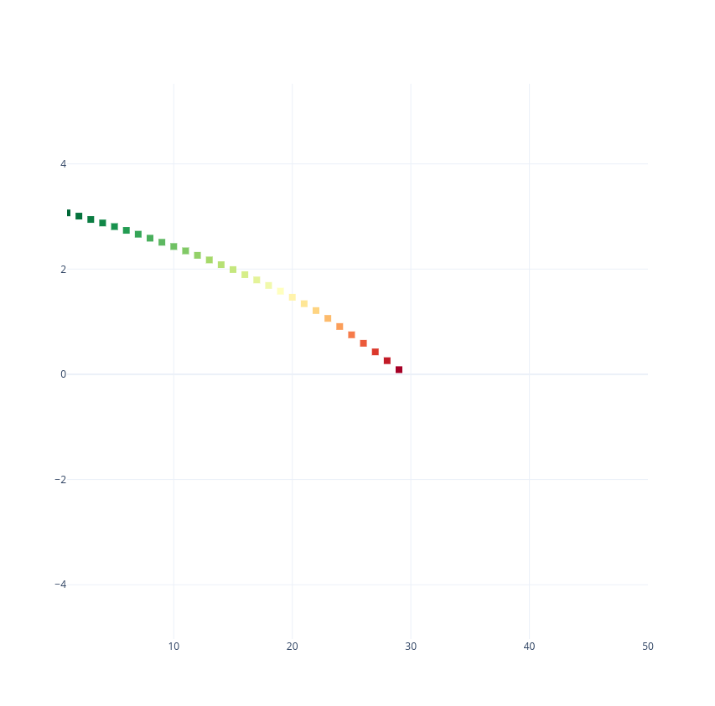
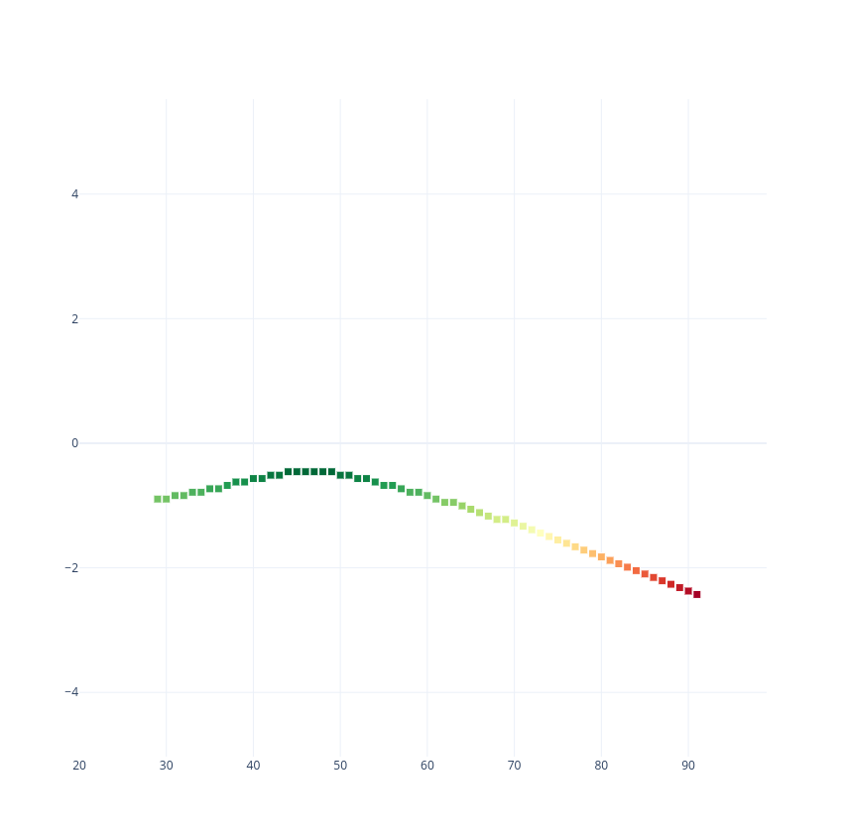
FG EPV by Yard Line
Punt EPV by Yard Line
Expected Possession Value (Points)
Expected Possession Value (Points)
Yard Line (Goal to 50)
Yard Line (Opp 20 to Own 1)
Notes:
Speaker Notes
Jeremy Levitt: These are the graphs of expected points by yardline and yards-to-go for field goals and punts. They are both pretty intuitive, but here are a few notes about each:
FG EPV:
Starts out at 3, which makes sense. If you take a field goal at the 1 yardline, you are guaranteed conversion almost 100% of the time.
FG EPV is downward sloping until around the 28 yardline. At this point, FG EPV becomes negative and no longer is a decision to consider.
The graph overall explains itself.
Punt EPV:
The punt EPV has a parabolic shape to it, maxing out at around the 46 yardline. If a team chooses to punt at the 30 yardline, a touchback can result- they must make sure they punt it a short enough distance. However, around midfield, the (college-kicker avg) punter can kick it about as far as they can, resulting in the most returns at the 0-10yrdline interval. This would explain this increase from the 30 yardline to midfield.
After midfield, the punt EPV decreases because the opposing team will be closer to their goal line.
Notice that punt EPV is always negative. This is because punting gives the other team possession and therefore an opportunity to score, resulting in “negative” expected points for Cal.

Slide 9
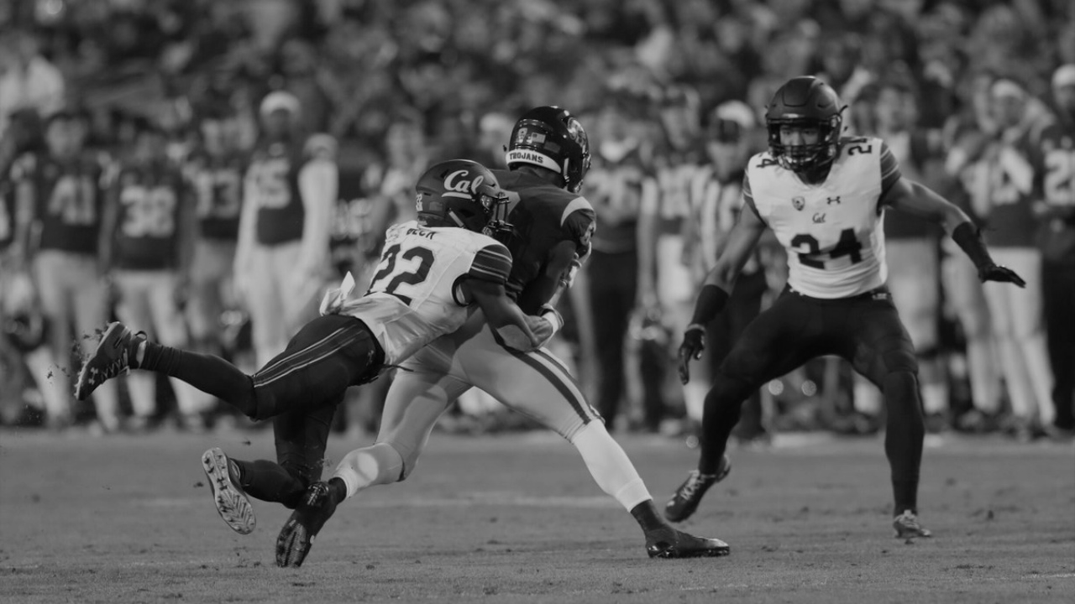
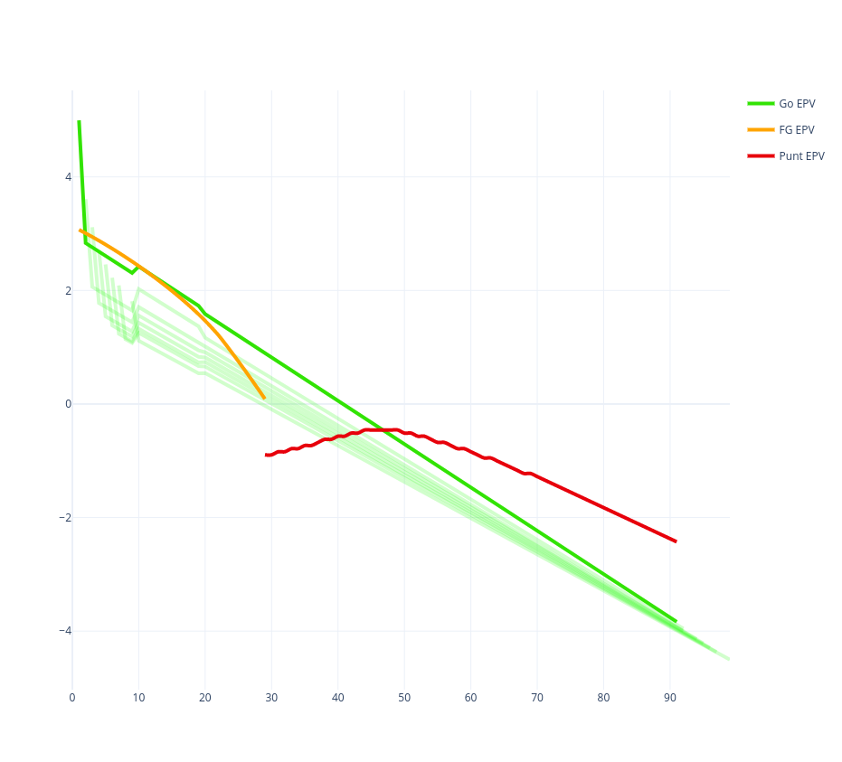
Point Maximization
Notes:
Speaker Notes
Jeremy Levitt: Our model concatenates these three graphs into one and uses maximization to suggest a decision. At any yardline, look at the corresponding curves, and whatever maximum of the values is outputted as the suggested decision.

Slide 10
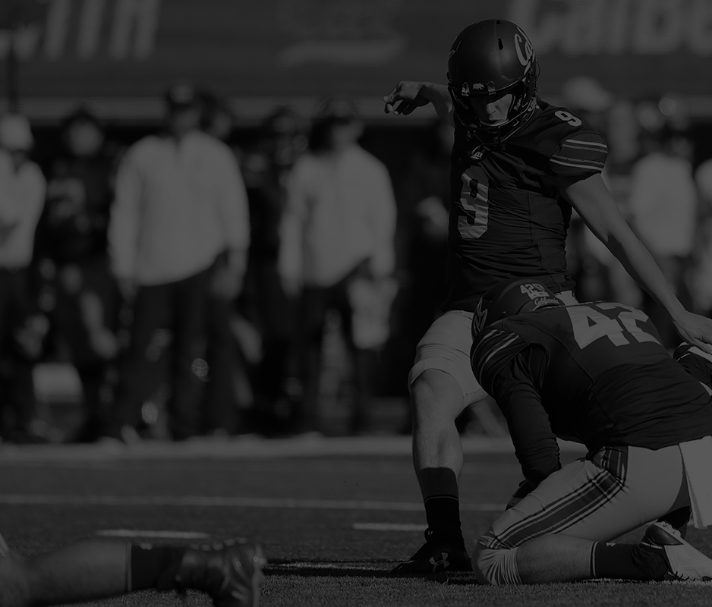
Conditions and Considerations
Conditions by which model can be safely used:
Non time-sensitive situation (end of half or game)
“Close” game (small score differential given time remaining)
Consider skill of individual punter and kicker on Cal
Kicker and punter are assumed to be “average” relative to D1 punters and kickers
Notes:
Speaker Notes
Andrew Rall:
Because our model is fundamentally a point maximization model, there are going to be some conditions and considerations that need to be taken into account in order for the model to be used safely and appropriately. First, the game must be in a non time-sensitive situation. Second, the score differential should be small relative to the amount of time remaining. Also, our model assumes Cal’s punter and kicker to be average realtive to all D1 punters and kickers.

Slide 11


Matchup Analysis
ESPN Offensive and Defensive Efficiency Ratings
Find most similar games to current matchup using past ratings
Weight EPV using historically similar game data
Notes:
Speaker Notes
Andrew Rall:
We wanted to keep the system by which we adjust our model for Cal’s upcoming opponent as simple yet also as effective as possible. We use two ratings systems devised by ESPN to customize our model, the Offensive and Defensive Efficiency Ratings. These ratings are on a scale of 0-100 and are standardized to be centered symmetrically around 50 (the average). Using Cal’s Offensive Efficiency Rating and the opponent’s Defensive Efficiency Rating the week of the matchup, we find the most similar games over the past 10 years across all teams in D1. We then weight the EPV values Jeremy defined earlier using this historical game data.

Slide 12
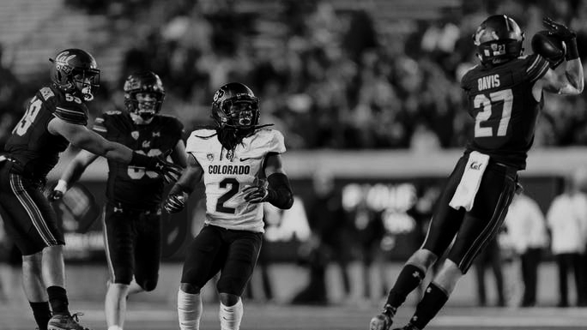
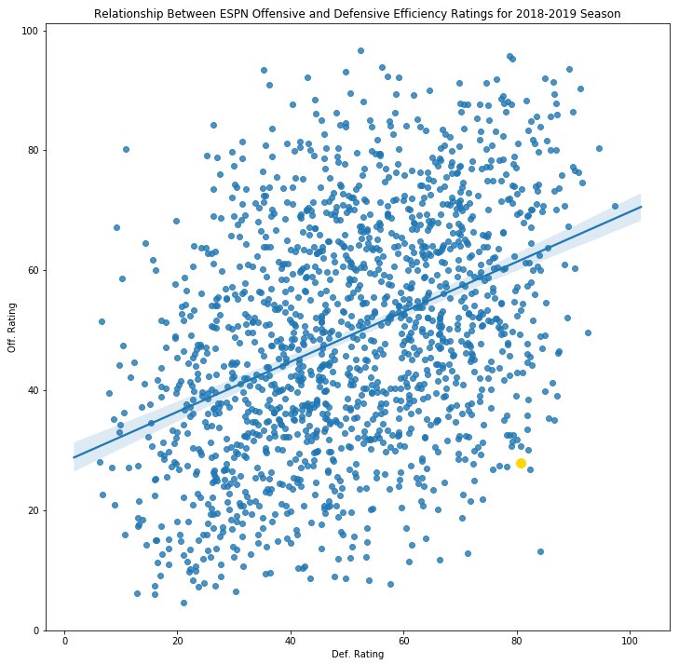
Cal Offensive Rating: 27.9
Cal Defensive Rating: 80.7
Stanford Offensive Rating: 72.3
Stanford Defensive Rating: 62.4
CAL
Notes:
Reference Matchup Chart.

Slide 13

Summary
We provide thin but detailed decision booklets
Our model uses EPVs to make decisions
Our charts include raw values
Our charts should be used in Non time-sensitive and close-game situation
Notes:
Speaker Notes
Charlie Xu:
As a summary, our team provides thin but detailed decision booklets. As mentioned before, our model uses EPVs to make decisions.Something to remember is that our charts should be used in Non time-sensitive and close-game situation. Most importantly, our model provides suggestions and information while handing the control back to the coaches. We treasure and believe in coaches’ experience and expertises . Therefore, unlike championship analytics which provides decisions as instructions, our charts provide the rationales of the decisions acting as detailed and big-data-based tools coaches can use. With our chart, coaches are able to combine conventional football wisdom with statistical model and make informed decisions.

Slide 14

Questions
&
Feedback
Notes:
Question & Feedback

